Slide 1


Lecture 06
Irfan Malik
Dr. Sheraz Naseer

Slide 2
Agenda
Diffusion Models
Negative Prompting
Stable Diffusion 2.1
How it works

Slide 3
Previous lecture:
Lecture 05 - Prompt Engineering
Click Here

Slide 4
Diffusion Models

Slide 5
Stable Diffusion

Slide 6
Negative Prompting
Not just what you want, but what you don't want.
Positive prompts
Generate a high-resolution image of an autumn forest scene with vibrant foliage, scattered leaves on the ground, and warm sunlight filtering through the trees. Capture the essence of a crisp fall day with detailed textures and realistic colors, Sun light, shades, 4k realistic, unreal engine
Negative Prompt
blurred, Non realistic, low quality, cartoon, art, paper, painting

Slide 7
Negative Prompting Examples
Positive prompts
fine-art photography of a Clear crystal cube, reflecting the seaface, floating on the tumultuous sea, Arctic Ocean, sunset, magic time, by Andreas Rocha, Minimalism, artistic, atmospheric, masterpiece, golden ratio composition, hyper-detailed, 8K wallpaper
Negative Prompt
blurred, Non realistic, low quality, cartoon, art, paper, painting
Parisian luxurious interior penthouse bedroom, dark walls, wooden panels
no gold, pink, Blurry, low quality, less details

Slide 8
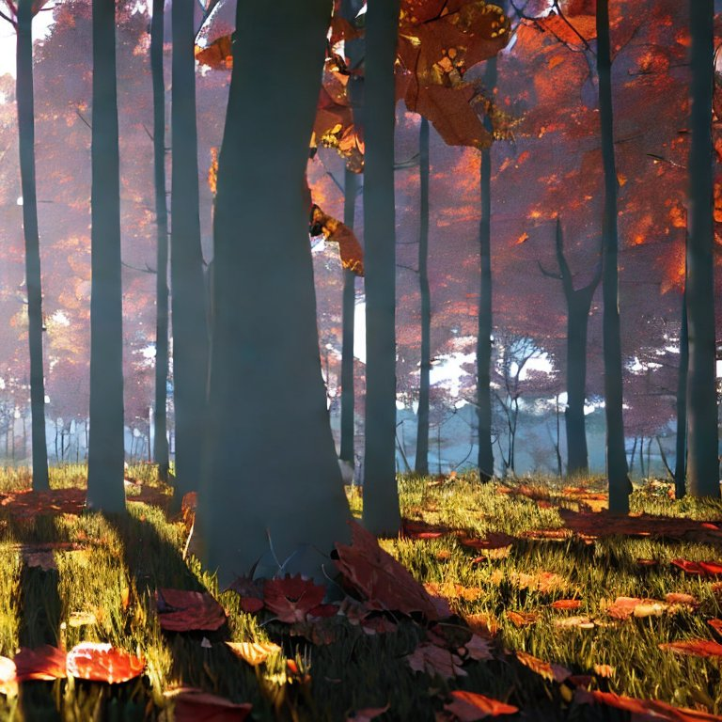
Prompting Examples I
Positive prompt: Generate a high-resolution image of an autumn forest scene with vibrant foliage, scattered leaves on the ground, and warm sunlight filtering through the trees. Capture the essence of a crisp fall day with detailed textures and realistic colors, Sun light, shades, 4k realistic, unreal engine
Negative Prompt: Low Quality, unreal trees, deformed trees

Slide 9
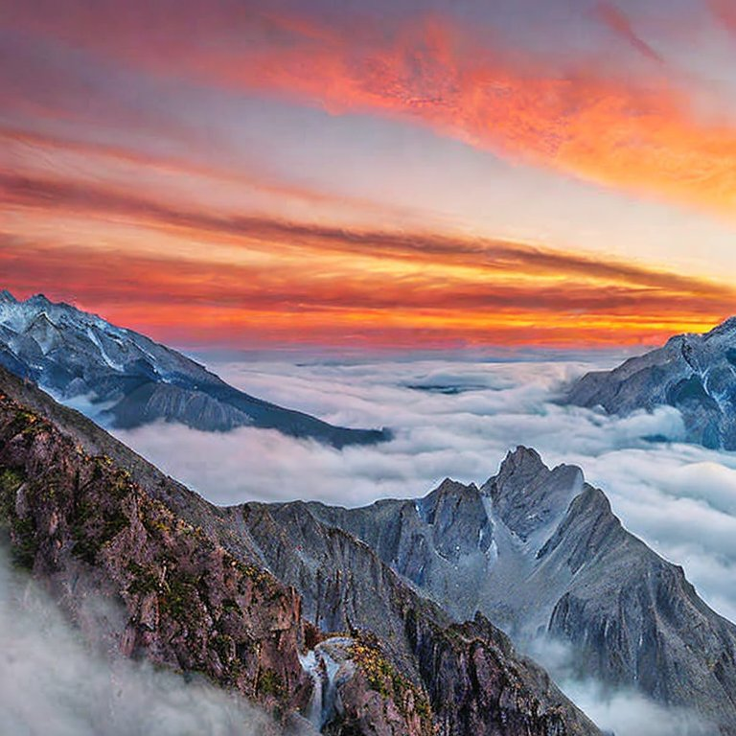
Prompting Examples II
Positive prompt: Lonely peak, peeks above clouds, sunrise paints it golden pink. Misty valleys below, waterfall sings, magic feels close. Picture-perfect view, soft colors, like a dreamy painting.
Negative Prompt: blurry, out of focus, flat lighting, harsh shadows, man-made elements, text, visible brushstrokes, pollution, cropped, cartoonish, low resolution, unnatural colors.

Slide 10
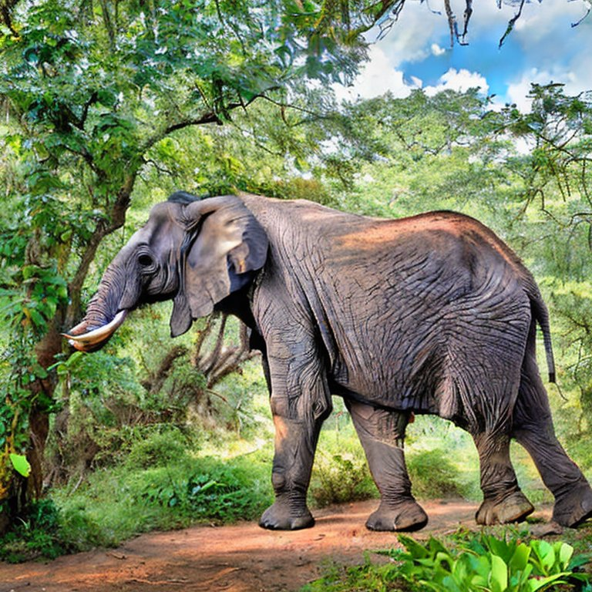
Prompting Examples III
Positive prompt: Generate an image of a majestic African elephant walking gracefully in a dense, sunlit jungle. The elephant should have gray skin with prominent wrinkles, and it should be reaching for leaves on a tall tree. The jungle should include lush green foliage, a clear blue sky. Include rocks and a small stream for added realism. The atmosphere should feel peaceful and serene. The image should have a resolution of at least 1920x1080 pixels and maintain high-quality details
Negative Prompt: blurry, out of focus, flat lighting, harsh shadows, man-made elements, text, visible brushstrokes, pollution, cropped, cartoonish, low resolution, unnatural colors.

Slide 11

Prompt Selling

Slide 12
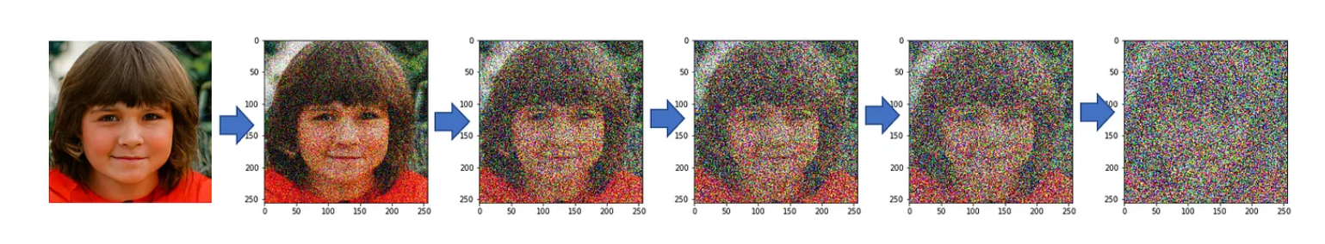
Diffusion Models
Noising the Images forward process
Noise refers to unwanted information that disrupts the clarity and accuracy of the picture.

Slide 13
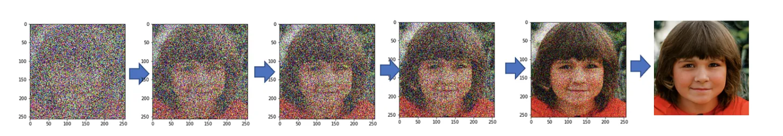
Diffusion Models
De-Nosing the Image Backward process

Slide 14
Stable Diffusion

Slide 15
Stable Diffusion

Slide 16
DALL.E3
DALL.E3 is a text-to-image AI model developed by OpenAI. It operates by taking a text prompt and generating a series of matching images.
It is trained on millions or billions of text-image pairs ,allowing it to understand complex concepts and create contextually relevant visuals.
It tends to produce more abstract or computer-generated images.

Slide 17
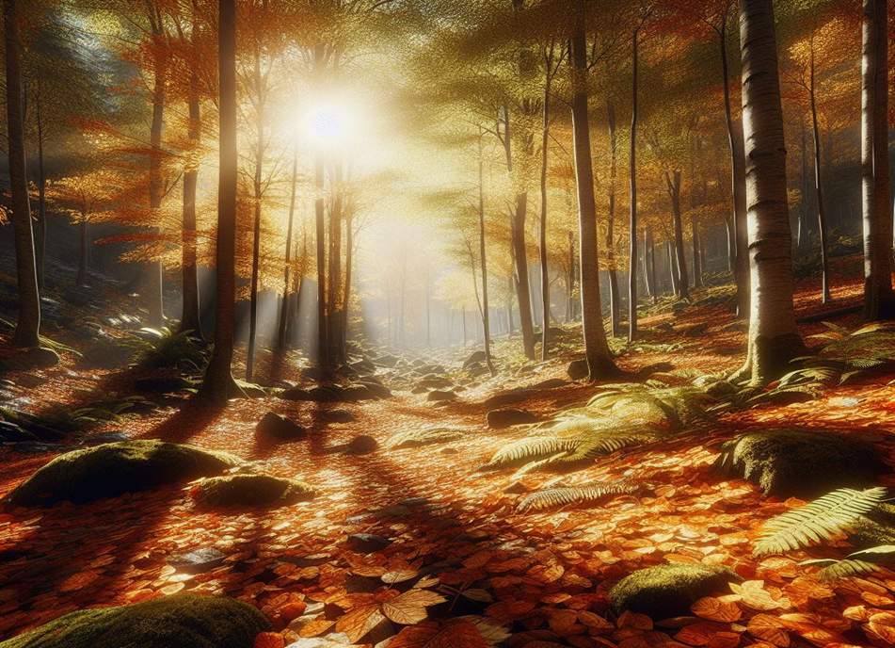
Generated by DALL-E 3
Positive prompt: Generate a high-resolution image of an autumn forest scene with vibrant foliage, scattered leaves on the ground, and warm sunlight filtering through the trees. Capture the essence of a crisp fall day with detailed textures and realistic colors, Sun light, shades, 4k realistic, unreal engine
Negative Prompt: Low Quality, unreal trees, deformed trees

Slide 18
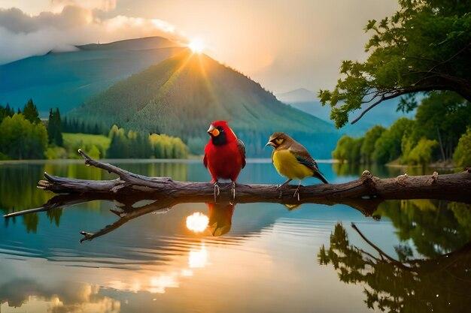
Generated by DALL-E 3
Positive prompt: Generate a high-resolution image of Two friendly domestic canaries enjoying a breathtaking sunset view from a branch, casting long shadows on the glassy surface of a lake below.
Negative Prompt: Low Quality, perched on a broken branch in front of a dark and stormy sky.

Slide 19
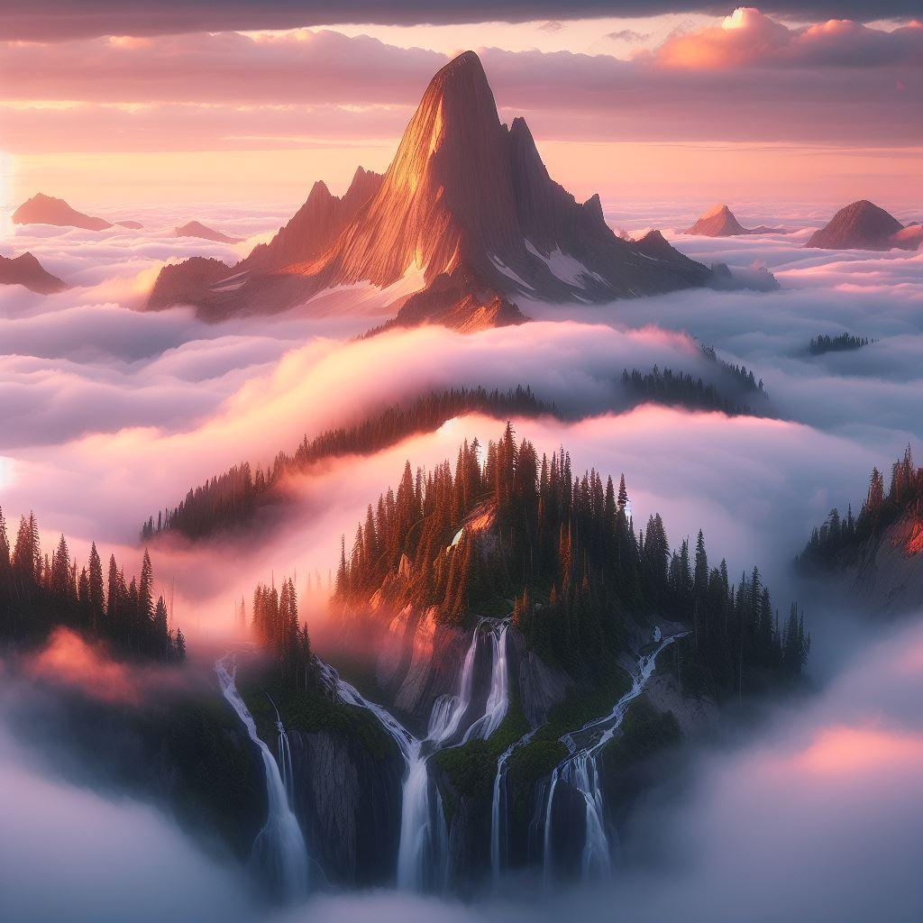
Generated by DALL-E 3

Slide 20
Best Practices
Understand the model: Familiarize yourself with the strengths and limitations of the language model you are using.
Start simple: Begin with straightforward prompts and gradually refine them based on experimentation and feedback.
Domain-specific prompts: Tailor prompts to specific topics or domains to enhance response quality in specialized areas.

Slide 21
Week Summary
Prompt Engineering
Best Practices
ChatGPT PlayGround
Stable Diffusion Prompting

Slide 22
Next Lecture:
Lecture 07 - Programming Fundamentals
Click Here

